Slide 1
Inquiry into Ensuring Free and Fair Local Government Elections During COVID-19
Dr Fareed Abdullah
Steve Biko Academic Hospital
South African Medical Research Council
29 June 2021

Slide 2
affiliations
Director: Office of AIDS and TB Research (SAMRC)
Public Health Specialist and HIV Clinician, Division of Infectious Diseases, Steve Biko Academic Hospital
Steve Biko Academic Hospital Outbreak Response Team
GDOH Project Leader for Solidarity Fund Equipment and Nursing Support Projects
Honorary Lecturer, Division of Infectious Diseases, Health Sciences Faculty, University of Pretoria

Slide 3
introduction
Many factors influence the evolution of the pandemic
Host, pathogen and environmental factors
Host factors include natural and vaccine-induced immunity
Age, comorbidities and BMI
NPIs, Human behavior and lockdown restriction levels
Social class, mobility, modes of transport

Slide 4
introduction
Pathogen factors are not well understood and include contagiousness, severity of disease caused and age distribution
Mutations are the pathogen enigma
Environmental factors include population density, geographic spread

Slide 5
Patterns of spread
Wave forms
Size and shape of waves
Exponential growth, peaks and troughs
Inter-wave period and inter-peak periods
Seeding events, cluster outbreaks and wave triggers

Slide 6
The fourth wave - when

Slide 7
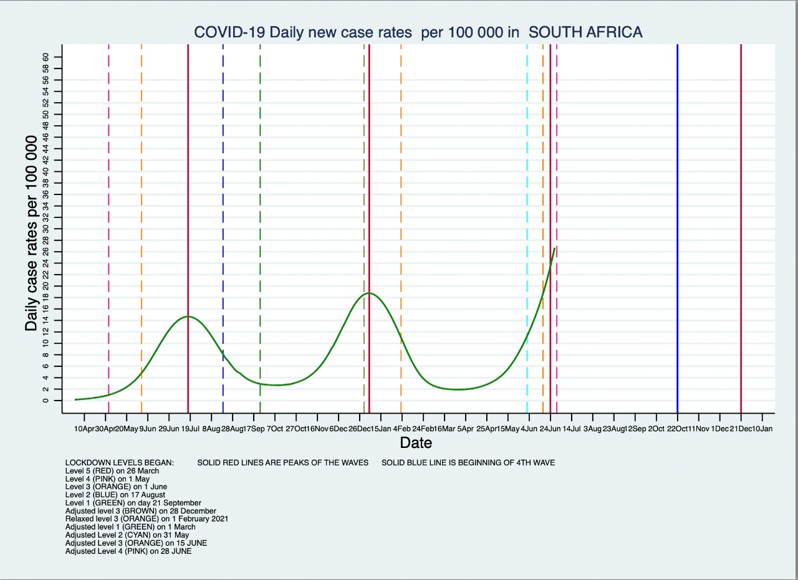
Fourth wave – when?

Slide 8
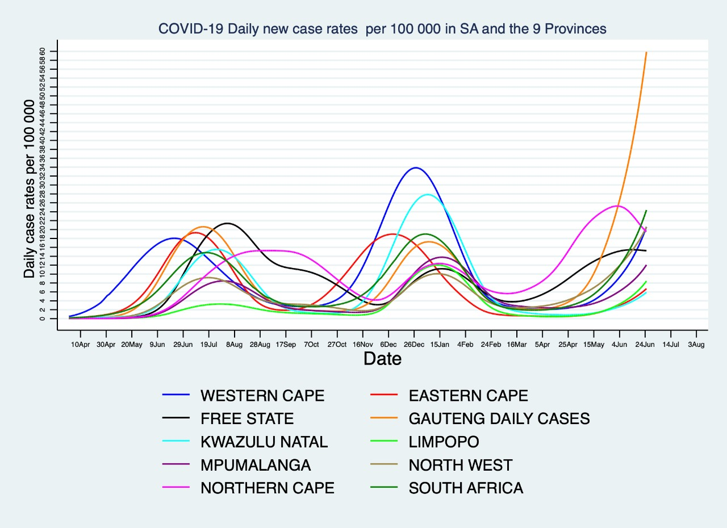
Interprovincial and local variability

Slide 9
Interprovincial and local variability

Slide 10
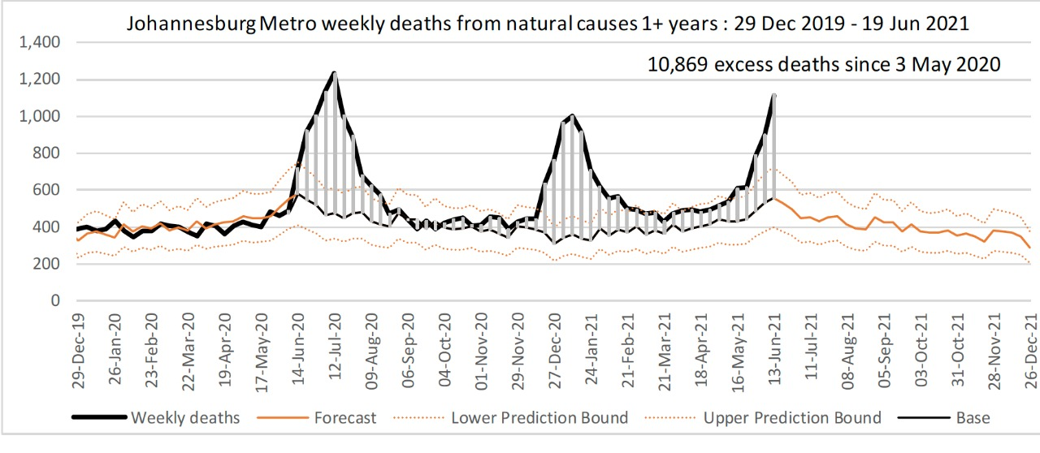
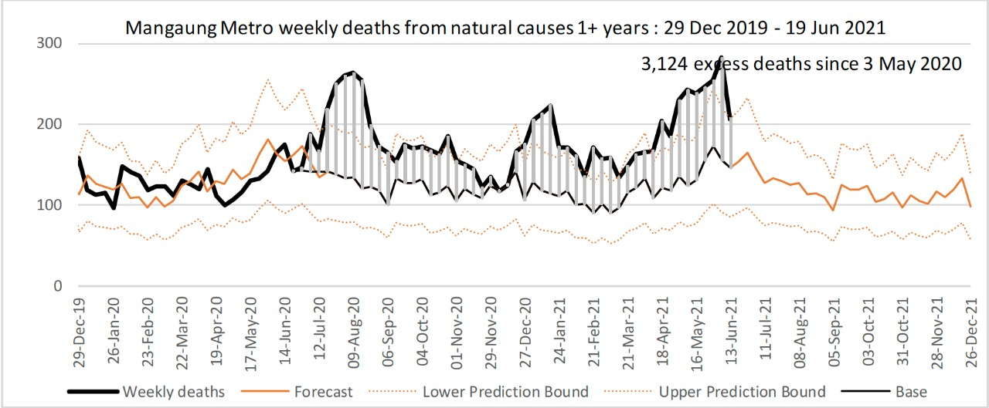
Variability across municipalities

Slide 11
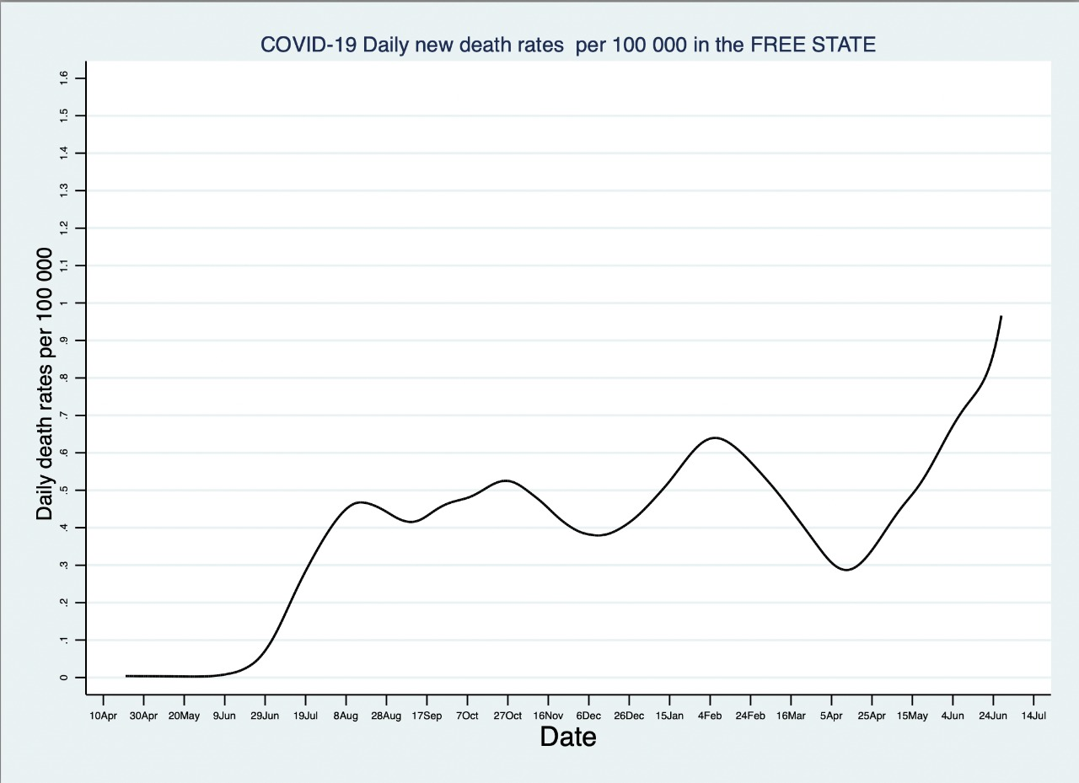
deaths variability free state

Slide 12
Vaccines and variants
Delta and Beta natural immunity
JNJ and Pfizer vaccine induced immunity
New mutations
Contagiousness
Vaccine coverage
Mid disease, severe disease, death

Slide 13
Conclusion
All or parts of the country will be in a wave for the foreseeable future
With a monumental effort vaccine coverage could be achieved next year
Must see flattening of the mortality curve
Postpone elections till declines in mortality are achieved
Continuing with current plans put thousands of lives at risk

Slide 14
Thank you for your time and attention

Slide 15
acknowledgements
Prof Jonny Myers (UCT)

